Slide 1
Technical Debt
By Juny Santeliz

Slide 2
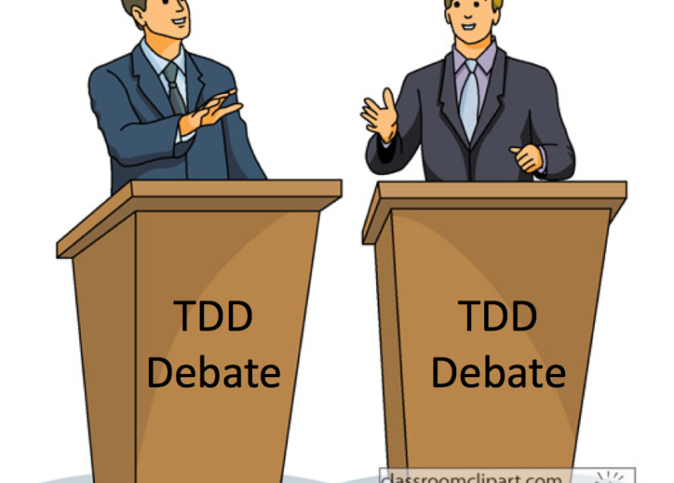
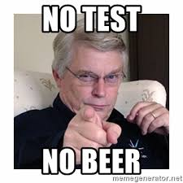
Key takeaways:
Be able to identify technical debt when we see it.
How knowing about it, helps us and our future teams.
Taking a proactive, thoughtful approach towards it.
Illuminating passage: “One thing often feeds on the other. Because the system is hard to change, it does not get necessary features. Because it does not have necessary features, it provides less business value. Because it provides less business value, there is less of a budget for improving it.” –yCombinator Forums
Source: https://news.ycombinator.com/item?id=13416935

Slide 3
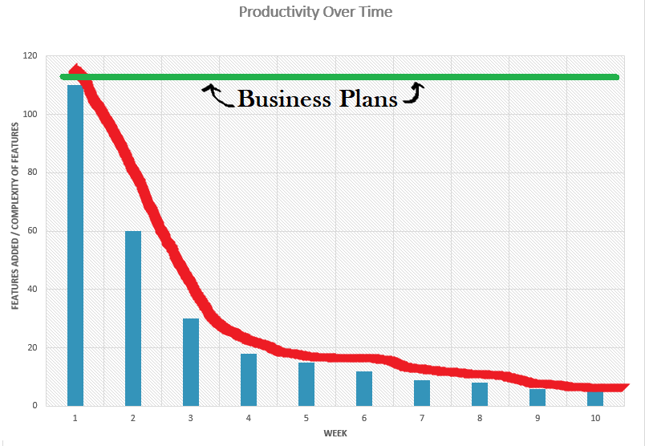
Productivity over time
Month
Source: “Uncle Bob” Robert C. Martin

Slide 4
Knowing is half the battle
By knowing about technical debt we can…
Be proactive agents in our roles as software developers…
By engaging in richer, more productive dialogue with our teams
Which ultimately makes our lives better!
Step 1
Step 2
Understand the user needs
Anticipate demand
Execute
Step 3

Slide 5


What is technical debt?
“Technical Debt is the trade off between the short-term benefit of rapid delivery and long-term value.” –Carnegie Mellon’s Software Engineering Institute
Example with:
TDD, refactoring, thoughtful consideration are engaged in, delivery time 6 months.
Example without:
No TDD, refactoring, or thoughtful consideration, delivery time 2 months.
Source: https://www.forbes.com/sites/falonfatemi/2016/05/30/technical-debt-the-silent-company-killer/#4acab65f4562

Slide 6
So how can we be proactive about technical debt?
Consider scalability- anticipate user demand
Check regularly- does the code “flow”
Refactor weekly- “clean up” code
Utilize TDD- write test first, then code
Lastly… Engineering Effectiveness Teams (slide after next)

Slide 7
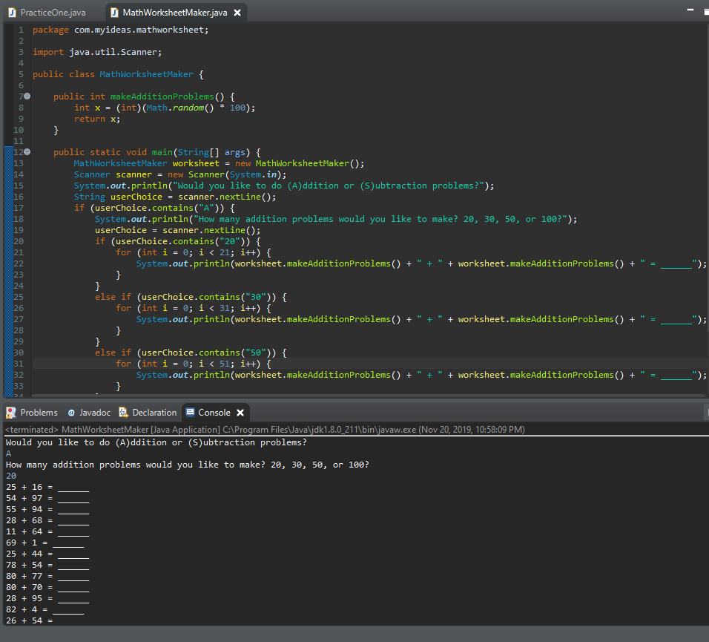
Let’s refactor!
Using switch and case instead of “if, else if”
Or having a dynamically generated number of problems based on user needs
Renaming method
Making more methods
Invoking these methods within “main”

Slide 8
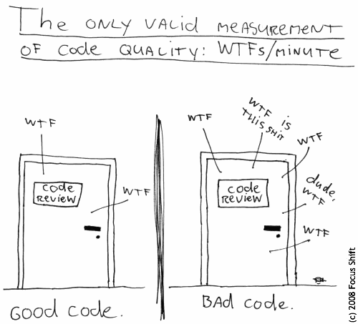
Engineering effectiveness Teams
Also known as, “Developer Productivity, Engineering Infrastructure, or Developer Efficiency”
Twitter utilized such a team
Noteworthy passage, “Every software company starts with a single line of code written by the first developer […]”
And another, “we’d all agree, I think, that it is possible to affect engineers’ productivity. At the very least it is possible to harm it.”
Source: http://www.gigamonkeys.com/flowers/

Slide 9
Fin. takeaways:
We’re able to identify technical debt when we see it -
Takes more time and effort to roll out features than it did before.
How it helps us and our future teams –
Enables management to give clients more accurate estimates, which helps the business, and ultimately helps us.
Taking a proactive, thoughtful approach towards tech debt –
Think of user needs, demand, TDD, regular refactoring, and when all else fails, Engineering Effectiveness Teams

